Slide 1

Navigation
Slide A
Turn and Talk
Many of our ideas for future investigations were related to trying out some collisions ourselves.
What sorts of things would we want to observe more closely in a collision that may or may not result in damage?
Notes:
Discuss initial ideas. Project slide A. Give students a couple of minutes to talk with a partner. Then ask students to share a few ideas. Listen for ideas such as these:
Observing collisions in slow motion might help us see what’s happening.
Look up close to try to see what is happening with the materials, both when they break and when they don’t.
Make note of how the material behaves in those situations and any changes we see happening to it.
Compare the objects before and after the collision.
Say, So although there is a “before” and “after” for a collison, and it's easy to compare these, one big area of interest for us is to try to see what is going on during the collision itself. Trying to see what is going on up close sounds like one thing we are going to want to try to do. But, knowing that the objects might get damaged and if that happens, pieces may get broken off in some of the collisions, what is one big safety precaution we are all going to want to take during our attempts to study collisions up close?
Listen for safety suggestions that include wearing goggles and not getting too close.

Slide 2
Roles
Slide A.75
Materials Master
Responsible for getting and putting back materials
Writer
In charge of writing down initial observations, questions, challenges
Must share with the rest of class
Observer
Coordinates with the writer to gather data
Notes:
Discuss initial ideas. Project slide A. Give students a couple of minutes to talk with a partner. Then ask students to share a few ideas. Listen for ideas such as these:
Observing collisions in slow motion might help us see what’s happening.
Look up close to try to see what is happening with the materials, both when they break and when they don’t.
Make note of how the material behaves in those situations and any changes we see happening to it.
Compare the objects before and after the collision.
Say, So although there is a “before” and “after” for a collison, and it's easy to compare these, one big area of interest for us is to try to see what is going on during the collision itself. Trying to see what is going on up close sounds like one thing we are going to want to try to do. But, knowing that the objects might get damaged and if that happens, pieces may get broken off in some of the collisions, what is one big safety precaution we are all going to want to take during our attempts to study collisions up close?
Listen for safety suggestions that include wearing goggles and not getting too close.

Slide 3




Investigation Guidelines
Slide A.5
DO
Droppers should wear safety goggles
YOUR assigned role
Drop objects no higher than shoulder height and about an arms length away
DO NOT
Wear no eye protection
Do whatever you want
And most importantly, DO NOT THROW OBJECTS ACROSS THE ROOM
Consequences
Including, but not limited to:
Detention
Kicked out
Call home
Notes:
Discuss initial ideas. Project slide A. Give students a couple of minutes to talk with a partner. Then ask students to share a few ideas. Listen for ideas such as these:
Observing collisions in slow motion might help us see what’s happening.
Look up close to try to see what is happening with the materials, both when they break and when they don’t.
Make note of how the material behaves in those situations and any changes we see happening to it.
Compare the objects before and after the collision.
Say, So although there is a “before” and “after” for a collison, and it's easy to compare these, one big area of interest for us is to try to see what is going on during the collision itself. Trying to see what is going on up close sounds like one thing we are going to want to try to do. But, knowing that the objects might get damaged and if that happens, pieces may get broken off in some of the collisions, what is one big safety precaution we are all going to want to take during our attempts to study collisions up close?
Listen for safety suggestions that include wearing goggles and not getting too close.

Slide 4
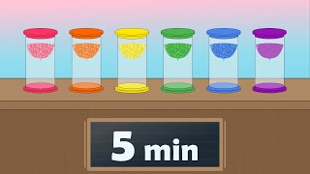



Investigate Dropping and Breaking
Slide B
With Your Group
Follow your teacher’s directions to make observations while you drop things and break stuff.
Observing Collisions
Descriptions of collisions
Challenges or questions
Record observations in your science notebook.
Note any challenges you face and any new questions that emerge.
Notes:
Carry out station investigations. Show slide B. Assign students to groups and initial stations. Keep track of time, reminding students to try multiple collisions. Students should be able to complete three collisions in the time allotted.

Slide 5

Discuss Design Challenges: Dropping and Breaking
Slide C
With Your Group
Discuss the following questions:
What did you notice about the motion or shape of colliding objects?
What challenges did you face?
How could we study collisions more easily?
Be ready to share your ideas with the class.
Notes:
Discuss investigation design challenges. Project slide C. Give groups 2 minutes to discuss the questions on the slide:
What did you notice about the motion or shape of colliding objects?
What challenges did you face?
How could we study collisions more easily?
Then lead a whole-class discussion to identify similarities and differences in observations about changes in motion or shape, challenges faced, and new questions that emerged.
Elicit observations about changes in motion and shape of colliding objects. Say, It sounds like in some cases we noticed changes in both the motion and the shape of colliding objects. This may be something we want to investigate further, but let’s identify any challenges we encountered testing collisions the way that we just did.
See teacher edition for suggested prompts and sample student responses.

Slide 6

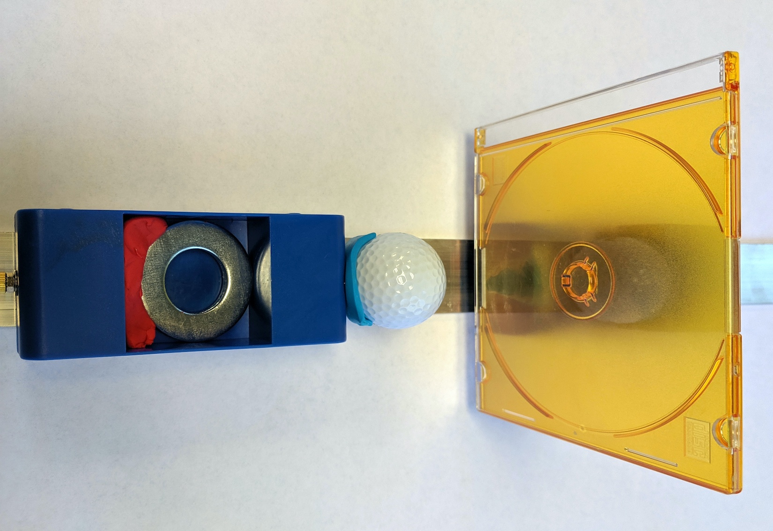
Controlling Collisions
Slide D
With Your Class
How would investigating collisions using this sort of setup help us address some of the challenges we encountered in the previous investigation?
Notes:
Say, I think we can do some things to control for many of these variables in our next round of collision investigations. I have some equipment we can use that I think might help address some of the challenges you raised. Let’s consider how the available equipment could be used to help address those challenges.
Project slide D. Say, In this image putty was used to attach a golf ball to a cart and it was also used to attach a CD case to a second cart. Notice that both carts are also on a track. This is just one sample of two different kinds of things we could collide together. We could swap in other objects and still attach them to carts using putty. Discuss the question on the slide as a class.
See teacher edition for suggested prompts and sample student responses.

Slide 7

Controlling Collisions
Slide E
Turn and Talk
When the objects that are part of the two subsystems make contact during a collision, what sort of changes do you think you might observe in those objects or in the subsystems they are attached to?
Notes:
Turn and talk. Project slide E. Ask, When the objects that are part of the two subsystems make contact during a collision, what sort of changes do you think you might observe in those objects or in the subsystems they are attached to? Ask students to share a few responses and listen for ideas about whether the motion, the shape, or both motion and shape will change during a collision. For example, students might say that the cart subsystems will bounce backwards or stop, the CD case will wiggle or crack, or the putty will be squished more or less.

Slide 8
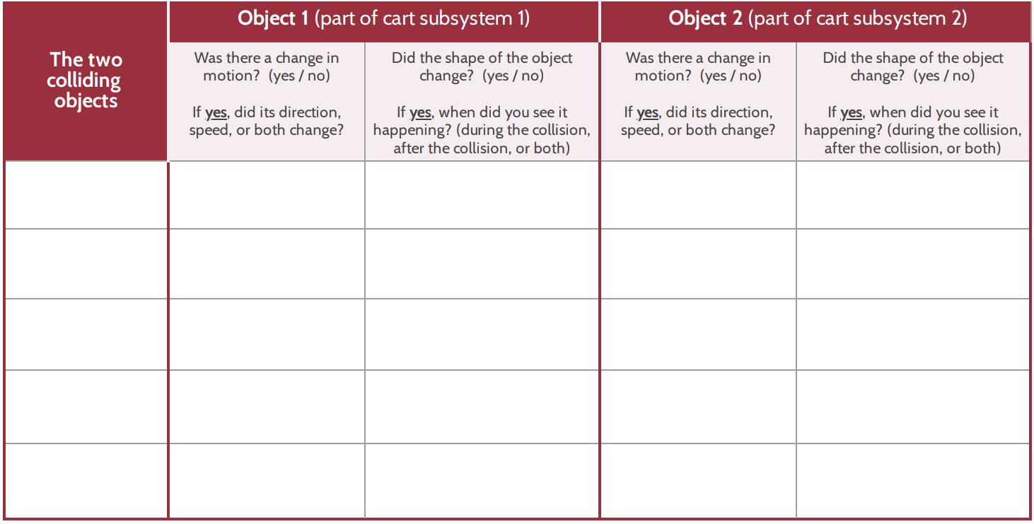
Explore Collisions: Motion and Shape
Slide F
Write our investigation question on your handout:
What happens to the motion and shape of the objects (and the subsystems they are part of) when they collide?
Notes:
Demonstrate controlling collisions with carts. Project slide F. Have students write the investigation question, What happens to the motion and shape of the objects (and the subsystems they are part of) when they collide?, on the top of their handout as described on the slide.
Prepare for data collection. Say, The data table provided has space for you to keep track of what is happening to two separate things for two different objects in the system, which is a lot for one person to pay attention to. Turn to your partners and take ten seconds to decide who is keeping track of changes in motion and shape for objects that are part of subsystem 1 and who is keeping track of changes in motion and shape for objects that are part of subsystem 2.
Demonstrate how to conduct the investigation. Say, I can use this setup to make the different subsystems collide by running the carts into each other like this (show a crash). Ask, What, if anything, did you notice during the collision about changes in the motion or shape of the objects? Hear a few responses.
Say, What about the surface of that CD case during the collision? What happens to it? Does it bend or break? Can it bend and not break? What are some tools we could use to help us see what is happening right at the moment two objects make contact and immediately afterward? Are there any technologies we could use to help us see what is happening to the objects that make contact with each other during that really brief event?
Listen for answers such as
slow down the speed of the objects before they collide or just push them slowly together instead of crashing them into each other,
try to take a photo of it as it happens and zoom in, and
use a slow-motion camera or use slow-motion video someone else collected.
Encourage students to pursue any ideas that they have technology to support.

Slide 9
Conduct an Investigation
Slide G
With Your Group
You will have 10 minutes for this investigation.
Record data on your handout.
Add your handout to your notebook when you are done.
Notes:
Explain organization of data collection. Point out that each row is for each different combination of objects they collide together. Students should have the freedom to choose whether to put both carts in motion or hold one steady and should clearly mark that they did so in the column on the handout that asks “Was there a change in motion? (yes/no).” If they hold one cart in place then they write “no (held in place) for one cart.”
Project slide G and tell students they will have three minutes at each station. Explain that if their group misses a station or are uncertain of the results and don’t have time to repeat the investigation at that particular station, they can fill in the corresponding cells of their data table with question marks.
Ask students to collect data for at least three stations. Assign students to work in groups, each at a different starting station. Signal the groups to rotate to a new station every three minutes. This should allow students enough time to get to at least 3 stations. Students should record data on their handout and add their handout to their science notebook when they are done.

Slide 10
Navigation
Slide H
In Your Notebook
In your notebook, look over your observations from our investigations.
Write a response to this question: What happens to the motion and shape of the objects (and the subsystems they are part of) when they collide?
Be ready to share your ideas with the class next time.
Notes:
Identify patterns in data related to changes in motion and shape. Say, Take a moment to summarize what you figured out about our question that motivated our investigation. Project slide H. Give students the remaining time to record their responses to the question:
What happens to the motion and shape of the objects (and the subsystems they are part of) when they collide?
If time is short, assign this for home learning.

Slide 11
Navigation
Slide I
With Your Class
Share your responses to this question from last time: What happens to the motion and shape of the objects (and the subsystems they are part of) when they collide?
Notes:
Identify patterns in data related to changes in motion and shape. Display slide I. Say, Last time you carried out an investigation to try to figure out what happens to the motion and shape of the objects (and the subsystems they are part of) when they collide.
Give students a minute to review what they wrote last time in the notebooks. Then have students share the summaries of their observations as a whole class, starting with observations related to changes in motion.
See teacher edition for suggested prompts and sample student responses.

Slide 12

Explore Collisions: Slow Motion
Slide J
Set up a T-chart in your notebook to record observations of slow-motion videos.
Observing Collisions in Slow Motion
Collision type
Observations
Notes:
Explain video observation procedures. Project slide J. Explain the objects involved in the three different collisions that will be shown in the videos. Give students a minute to create a T-chart for recording observations in their notebooks as shown on the slide. Explain that each video will be played twice. The first time it is played, students should pay attention to what is occuring. During the second viewing, students should record observations.

Slide 13
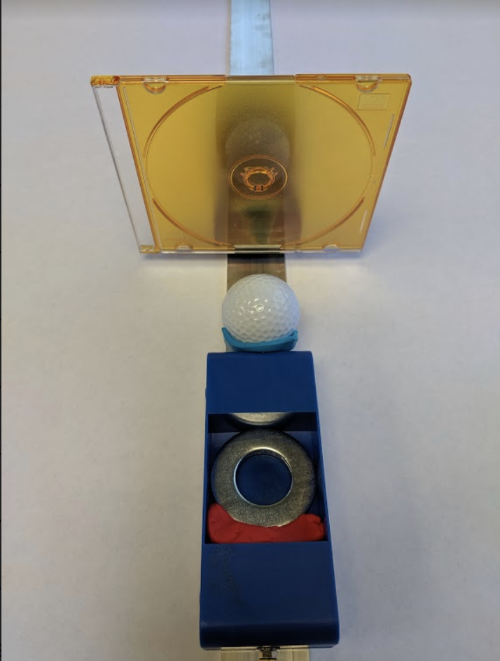
Slow-Motion Collision 1
Slide K
Notes:
Play videos and record observations. Project slide K. Check that the computer sound is turned off before playing the videos. Play video 1 in its entirety twice. Instruct students to watch the video the first time and to record observations in science notebooks during the second viewing. Continue this process with slides L and M and for the following clips:
Video 1 https://youtu.be/ZGN7zZrt-s0
video 2 https://youtu.be/8woJSebzTio
video 3 https://youtu.be/sqXNPgYEEA4

Slide 14
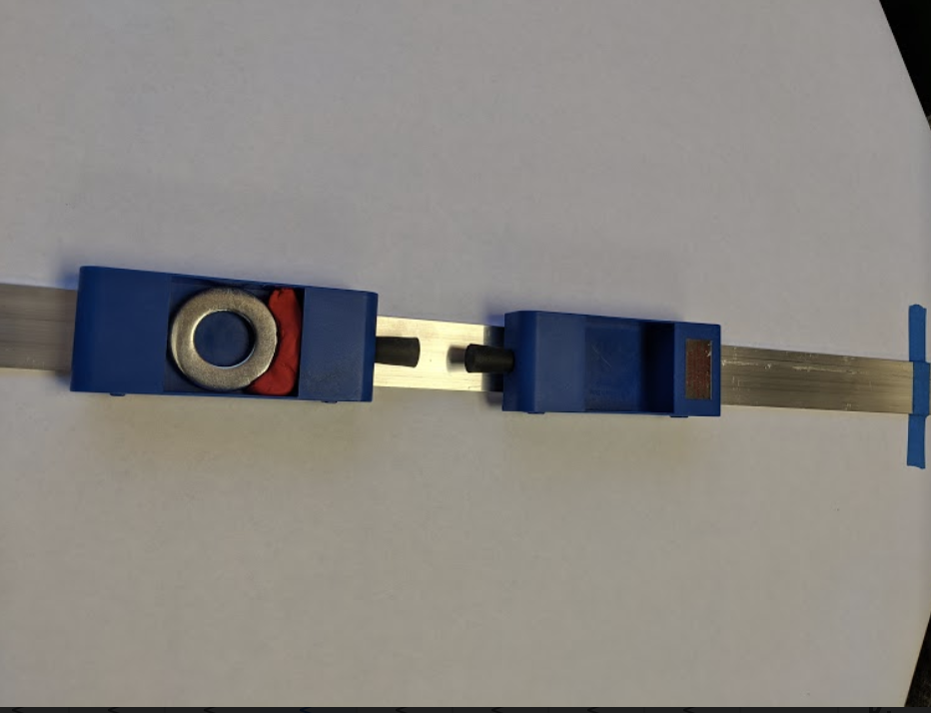
Slow-Motion Collision 2
Slide L
Notes:
Project slide L. Play Video 2: https://youtu.be/8woJSebzTio

Slide 15
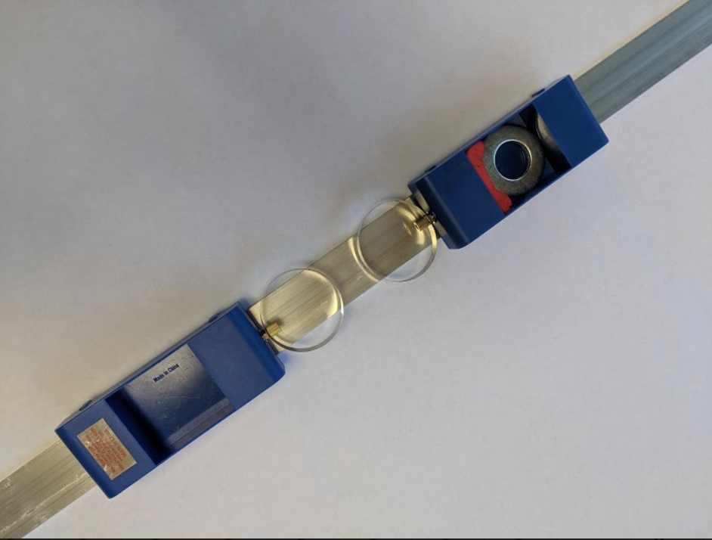
Slow-Motion Collision 3
Slide M
Notes:
Project slide M. Play video 3: https://youtu.be/sqXNPgYEEA4
After showing the 3 videos, say, Bring your notebooks and let’s meet in the Scientists Circle to share our thinking about the changes we are seeing when objects are in contact with each other during a collision.

Slide 16
Develop initial explanations
Slide N
Identify a mechanism or interaction that can help explain the changes we observed in colliding objects.
What causes a change in their motion?
What causes a change in their shape?
Be ready to share your ideas with the class.
Notes:
Identify the two types of outcomes we observed. Say, Earlier we found evidence for motion and shape changes in some collisions. When we analyze slow-motion video from collisions, we further evidence that those changes are happening gradually during the time the colliding systems were in contact with each other. Let’s consider what could be causing both of these types of changes.
Develop initial explanations. Project slide N. Say, As we try to figure out what’s happening at the moment of impact in a collision, it would be helpful if we could explain what is causing the changes we observed. Let’s each individually try to identify a mechanism or interaction happening between colliding objects that can help explain what we observed. Record your thoughts about what causes changes in motion in every collision case where we’ve seen that outcome. Then think of the cases where you saw evidence of a shape change. Record your thoughts about what you think might be causing changes in shape in all of those cases.

Slide 17
Progress Tracker: What have you figured out?
Create a 2-column chart in the Progress Tracker section of your notebook.
Write the question we are working on in the left column: What causes the changes in motion and changes in shape of colliding objects?
Write what you figured out in the right column. Use words and/or pictures. Take as much space as you need to record your thoughts.
Slide 0
In Your Progress Tracker
Progress Tracker
What I figured out
Question
Notes:
Project slide O. Tell students to add the lesson question to their Progress Trackers: What causes the changes in motion and changes in shape of colliding objects? Give students time to individually update their Progress Trackers with what they’ve figured out so far.

Slide 18
Navigation
Slide P
With Your Class
Take a poll:
Does the force from a collision always cause shape changes in the objects that collide, but sometimes we just can’t see or detect it?
Notes:
Consider whether shape changes happen in all collisions. Say, So we’ve seen shape changes in the collisons we’ve looked at, where slow-motion video provided the evidence we needed to see that change. And we think that forces in the collision cause this shape change. So is this something that is always happening? Do you think the force from a collision always causes shape changes in the objects that collide, but sometimes we just can’t see or detect it?
Project slide P. Take a quick poll in response to this question. Anticipate some controversy around this idea.
Say, It appears we have two competing claims in our classroom. Some of us think that all objects bend or change shape in a collision. And some of us think that not all solid objects bend or change shape in a collision. We are going to need data to support or refute either of these claims. But one challenge in trying to support or refute a claim where we are asking “does this happen in all cases” is that we can’t test all cases. So let’s brainstorm some types of objects or materials that we know are very rigid that we could test.

Slide 19
Brainstorm Materials to Test
Slide Q
In Your Notebook
Brainstorm some types of objects or materials that you know of that are very rigid that could be useful to test in order to investigate our new question.
Notes:
Brainstorm objects and sources of data needed to investigate our question. Project slide Q. Have students record their ideas in their science notebooks. If time is short, you may consider asking students to brainstorm objects and sources of data needed to investigate our question as a home-learning assignment.
Say, Let’s plan to investigate this question further next time to see if we can collect evidence to support one of these claims and refute the other one.

